Slide 1
Case Study
Pandit Ji Oncall

Slide 2
+91-856-00-00-600
www.dialerindia.com
avyuktaindia
CRM Based Dialer - IVR - Cloud Telephony
PRI Card - GSM Gateway - Servers - Headsets
(FXS/FXO/IP Phone// Press 1/ IP PBX)
Auto / Predictive / Hosted – WFH - PC Less – Android - Cloud Dialer
DoT Approved A / A+ Grade VoIP with/out Dialer Combo
Web / Software Development/e-Com / Custom Asterisk Solutions
+1-408-791-3820
+91-856-00-00-600
sales@dialerindia.com

Slide 3
Pandit Ji On Call Case Study
About Pandit Ji On Call
Pandit Ji on Call is an astrology consultant gives quick solution on the issues with astrology advice to people on the phone. They have a team of astrologers who are not only experienced, but also certified and educated professionals who work on combining ancient knowledge with modern times. Panditjioncall.com started with a unique concept of bringing from infinite to a finite state for an individual's astrological, legal, relationship, medical, career and healthy well-being. It is one stop solution platform where they are trying to make life easier for everyone.
Pandit Ji On Call’s Network
Extensive Reach across India and overseas.

Slide 4
Pandit Ji On Call Case Study
Kay Features of Pandit Ji On Call:
* No waiting Instant Access.
* Hassle free process.
* Astrological Details of your kundali.
* Current planetary transit and their effect.
* Privacy Guaranteed.
* Accurate remedial measures.
* Important tips to make situations easier.

Slide 5
Pandit Ji On Call Case Study
Challenges at Pandit Ji On Call
* New website, with nimble and conversation-inspiring "days at a glance“ Information
* clean interface, and ease of use
* Follow me Call Routing
* All Logs and History must be available under single roof.
* APIs and SMS Integration between Dialer and Website.
* Real time data sync between CRM , Dialer and customer accounts.
* Automatic updating between call timer, user balances .

Slide 6
Pandit Ji On Call Case Study
Pandit Ji On Call Requirements
The design pattern is a recurring component of the website that has been created. —
1. Such as a Customer registration, Package purchase, Pay online, sign-ups, log-in screens, etc.—used to solve common user problems.
2. One common design pattern that many website use—that Pandit ji on call adapts to their user base excellently—is the push notification.
3. User can view those messages like balance history, balance and transaction history etc.
4. All The calls needed to be recorded and must be available to check for quality and audit on just few clicks as the businesses needed real-time tracking of calls.
5. Calls must be routed to right member only, instead of random user with follow me algorithm.

Slide 7
Pandit Ji On Call Case Study
Solutions we implemented at Pandit Ji On Call
1. Distributed Call Center Solutions
2. Web SMS integrate ( WhatsApp, Massages, Email)
3. Integrated website and dialer system into Telephony interface
4. All Recording logs with entire history on just few clicks
Pandit Ji On Call’s Implementation:
Created Pandit Ji On Call website, in which we have added many features like
Customer registration
Package purchase
Pay online
Connect to astrologist easily.

Slide 8
Pandit Ji On Call Case Study
Distributed Call Center Solutions
Our Distributed Call Center Solutions implementation helped Pandit ji on Call to almost eliminated all above challenges
Web SMS integrate
This feature enables you to not only integrate SMS capabilities into your business systems, it also provides the ability to automate key functions surrounding the sending and receiving of text messages.
Call recordings Logs
With our solution Pandit Ji On Call is having centralised call recordings with all logs and history to evaluate / track work force’s performance at any point of time
We helped Pandit Ji On Call to solve another problem. To keep up with industry standards, Pandit Ji On Call needed to track their fleet progress, location and all other required stats in real time

Slide 9
Pandit Ji On Call Case Study
Telephony interface
Control and information are the defining characteristics of effectively integrated calling. You want to have an enabling system in place, through which you can implement a solution for your specific needs. The goal has to be to enable faster and more productive conversations.
Some of the key features to look for in your telephony integrated dialer are:
Skill-based routing
Calls flexibility
Caller authentication
Call data recording
Call monitoring
Automated dialling

Slide 10
Pandit Ji On Call Case Study
The Result
1. Our solution helped the client to manage their customers accounts with auditing and
monitoring tools. As well as the Product management on few steps only.
2. We helped them with implementation of Automation in process like balance updates, call
timers which reduced many manual resources costing with minimal time which improved the
overall productivity of work force drastically.
3. With over all implementation of our solution under Single roof integration of Website, CRM ,
Dialer system provided them proper reports for all satisfied and unsatisfied customers which
helps them to improve their services depending upon the reports and feedbacks from
customers.
4. Customer business has gradual increase in goal achievements from 60 % to 90 % in just few
months in key areas like revenue, customer reach, work force availability and Flexibility.

Slide 11
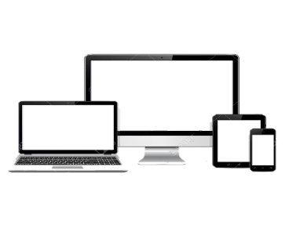
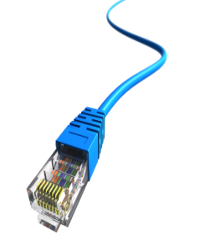
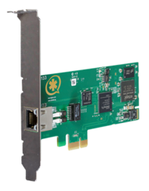
Pandit Ji On Call Case Study
Pandit Ji On Call Case Study
Call Flow and Architecture : Pandit Ji On Call
To Agents/Distributed/Centres/WFH/
To PSTN Network / From PRI
Website Hosted On Cloud /Internet only for Support Access
Agent Floor
Options: WFH/Distributed/Tab/PC/Mobile based Agents
WAN Modem / Router ( Optional )
Admin / Quality / Supervisor / TL PC’s
IP Phone
Soft Phone
Avyukta Dialer Server
USB Headphones
Secondary backup Server
Agent PC
PRI Card into PCI Slot
Switch
Or Hub
25+ Reports
Voice Logs
CAT 5/6
Barge / Snoop / Whisper
Campaign Manager

Slide 12
Political Elections / Campaigns
Insurance / Shares / Loan / DSA’s
Taxi Services / BPO / Collections
Survey / Appointment Setting / Lead generation
Astrology / Universities / Colleges
Recruitment / MIS / Placements / Admissions
Restaurant / Hotels / Customer Care
E com / Mobile Apps / Website
24 X 7 X 365 “Decade” of 1900+ Satisfied BPO’s
avyuktaindia
Predictive / Auto Dialer: Current Calls/ Output X 400%
Survey / Appointment Setting / Lead Generation
Domestic International Call Center / BPO Setup
Hosted / Premised / BPO / DoT VoIP / PRI / GSM Gateway
Smart IVR / Cloud Telephony / Omni Channel / CRM / API
OBD / Press 1/ Voice SMS / Masking / OTP / 1800
The Competition Assassinators
275+ Live Ref. Centres
11 Yrs. X Asterisks Dev.
9 Countries,91+ Cities
Live Demo / PoC
Lower than the Lowest Professional Bidder
All possible Techno-commercial models
No Blame Game : Your CTI-CRM-VoIP “SPOC”
100% Gov. Compliance
72 HR Refund Policy
10% Ref. discount/s
24X6 Support NoC
“The” single Answer to your
A to Z
Tel- ”e” - calling requirements
+1-408-791-3820
+91-856-00-00-600
sales@dialerindia.com
Avyukta Intellicall www.dialerindia.com

Slide 13
Trust over 11+ years
Some* Major Clients

Slide 14
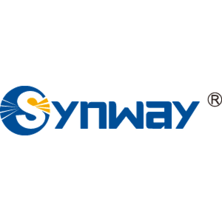
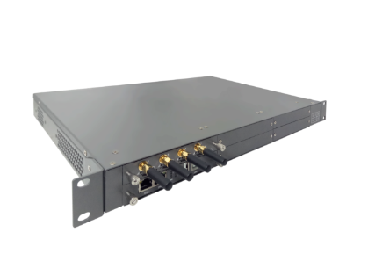
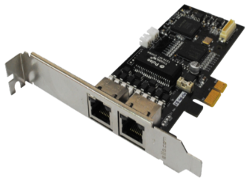
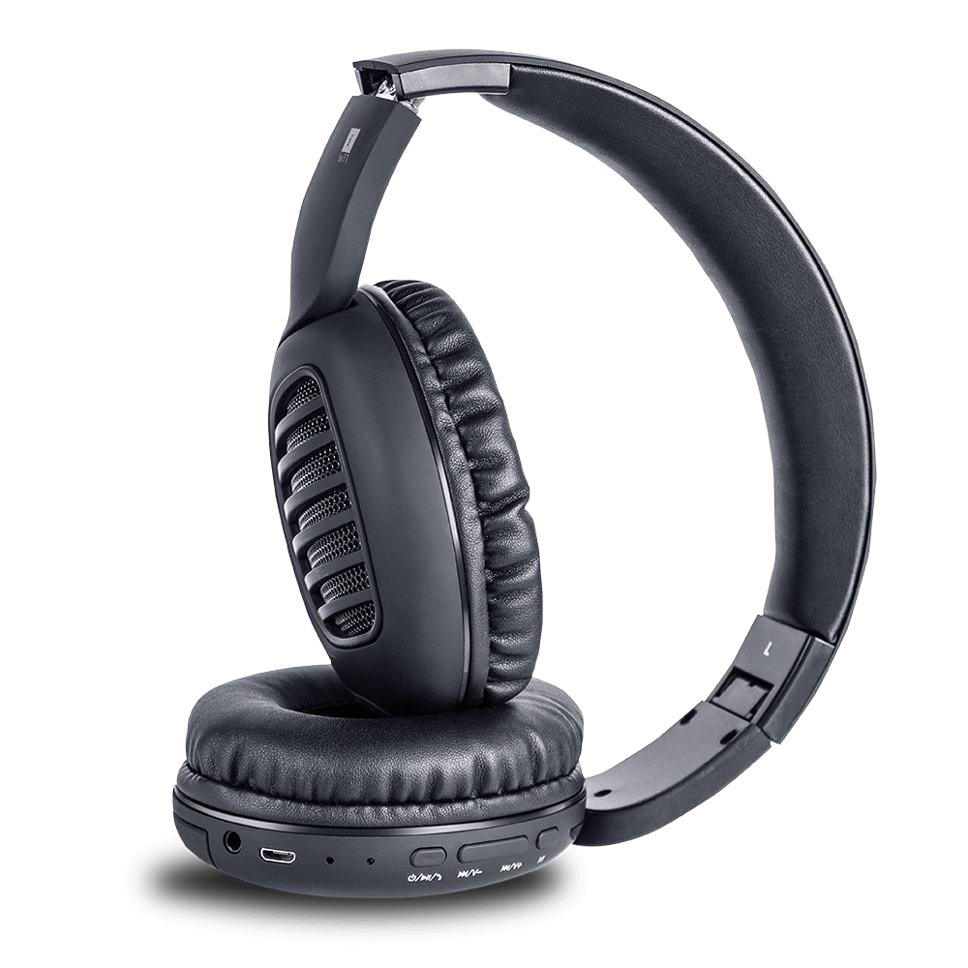
CTI Hardware Partners

Slide 15
Useful links
Domestic Architectures
International Architectures
Demo Video
Video Tutorials
Sample Voice Overs, Jingles and Melodies
DoT License / OSP Registration
PRI card / GSM Gateway / IP Phones / Headphone Buy Online
Vendor Comparison
Avyukta CRM Demo Video
Avyukta Sales CRM Demo Video
Avyukta Task CRM Demo Video
Avyukta Today CRM Demo Video
Request a Demo
Avyukta Client CRM Login
Support SLA
Avyukta on Youtube
Avyukta on Linkedin

Slide 16
Pandit Ji On Call Case Study
Thank You for Your Time

